Slide 1
PLOTTING GRAPHS

Slide 2
When plotting graphs, it is important to consider the importance of the following factors:
  Selecting appropriate scales
  Labelling axes with quantities and units
  Carefully plotting the points

Slide 3
Choice of Scale
When choosing a scale, it must be big enough to accommodate all the collected values using as much of the graph paper as possible
At least half of the graph grid should be occupied in both the x and y directions
Scales should be clearly indicated and have suitable, sensible ranges that are easy to work with
  For example, scales with multiples of 3 should be avoided
The scales should increase outwards and upwards from the origin
Each axis should be labelled with the quantity that is being plotted, along with the correct unit

Slide 4
Labelling the Axes
Label each axis with the name of the quantity and its unit
  For example, F / N means force measured in Newtons
The convention is that a forward slash ( / ) is used to separate the quantity and the unit
In general:
  The independent variable goes on the x-axis
  The dependent variable goes on the y-axis

Slide 5
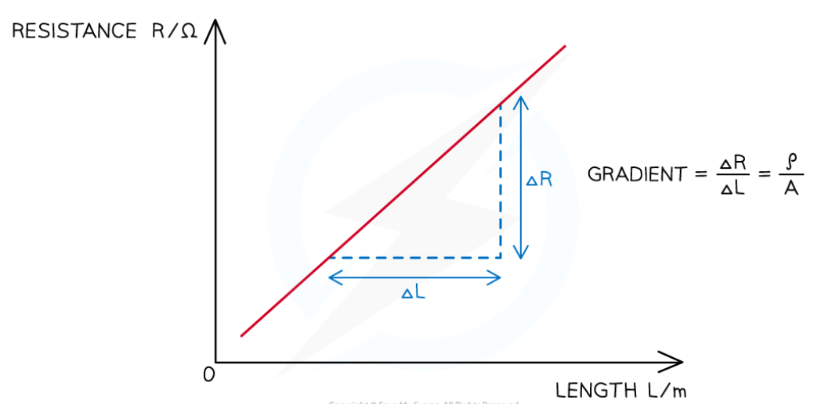

Slide 6
Plotting the Points
Points should be plotted so that they all fit on the graph grid and not outside it
All values should be plotted, and the points must be precise to within half a small square
Points must be clear, and not obscured by the line of best fit, and they need to be plotted with a sharp pencil so that they are thin
There should be at least six points plotted on the graph, with any major outliers identified

Slide 7
Line or Curve of Best Fit
There should be equal numbers of points above and below the line of best fit
  Using a clear plastic ruler will help with this
Not all lines will pass through the origin and nor should they be forced to
The line (or curve) of best fit should not be too thick or joined dot-to-dot like a frequency polygon
Anomalous values that have not been identified during the implementation stage should be ignored if they are obviously incorrect
  This is because they will have a large effect on the gradient of the line of best fit

Slide 8
Determining the y-intercept
The y-intercept is the y value obtained where the line crosses the y-axis at x = 0
Values should be read accurately from the graph, with the scale on the y-axis being interpreted correctly

Slide 9

Determining the gradient
To find the gradient, two points (x₁ , y₁ ) and (x₂ , y₂ ) that lie on the best-fit line should be chosen. The two points should be at least half the length of the line apart.
It is helpful to try to use points where the best-fit line crosses grid lines. You should only use plots from the table of results if the plots are clearly on the best-fit line.
Using this method, negative gradients are identified.

Slide 10
Worked Example
A student investigates the effect of placing an electric fan in front of a wind turbine. The wind turbine is connected to a voltmeter. When the wind turbine turns, it generates voltage. The student obtains the following results:

Slide 11
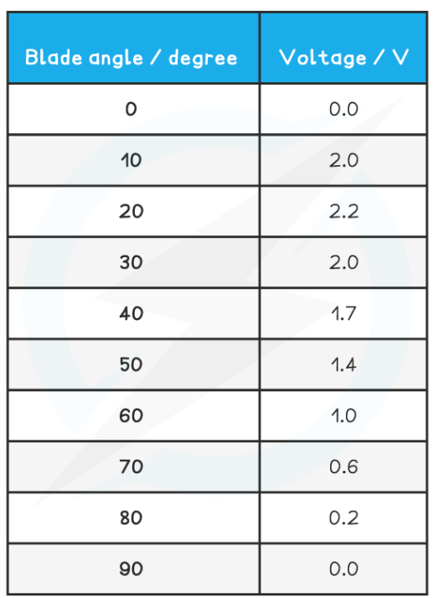

Slide 12
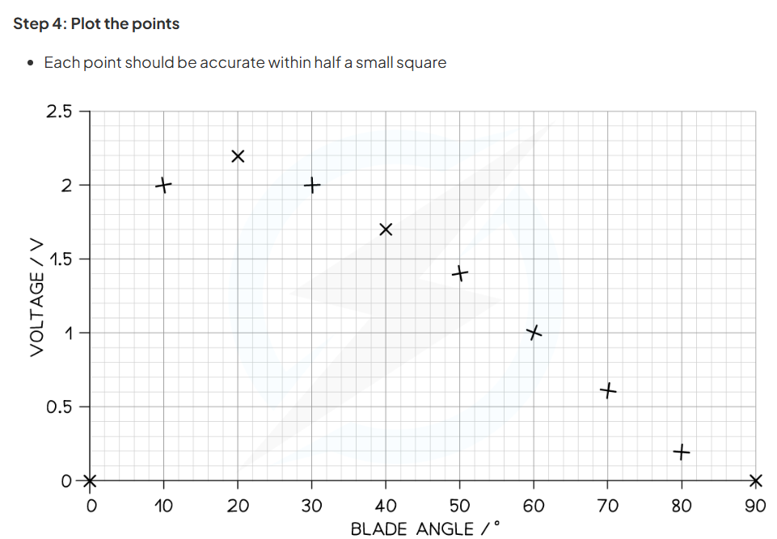

Slide 13
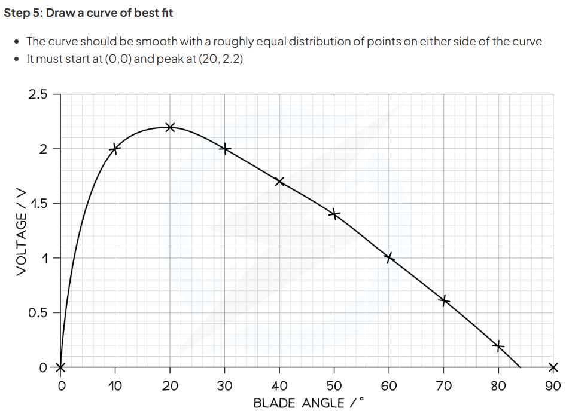

Slide 14
Plotting Graphs | Edexcel International A Level (IAL) Physics Revision Notes 2018
Determining Uncertainties from Graphs - AQA A Level Physics

